Slide 1
Stock Market Indices
Andrew Dzik

Slide 2

Question
What Stock Market Index has performed the best over the last 2 decades?
Are Indices worth buying over other types of stocks?

Slide 3
Getting the Data
Data was sourced from
https://www.kaggle.com/datasets/asimislam/30-yrs-stock-market-data
Contained a CSV of 30 years of daily stock data.
Includes stock market indices, resources, metals, and treasury notes.

Slide 4
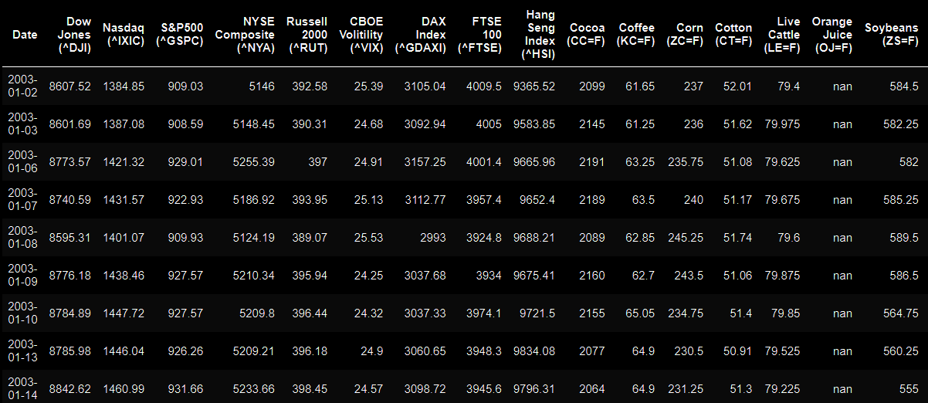
Initial Data

Slide 5
Exploring the Data
To simplify: Find the % change between a beginning and ending date.
(((latest/1.65) / original) - 1)*100 = % change
Organize: Categorize stocks and sort the datasets in descending order.
Total Inflation Over 20 Year Gap

Slide 6
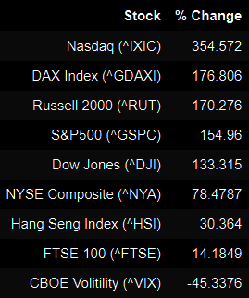
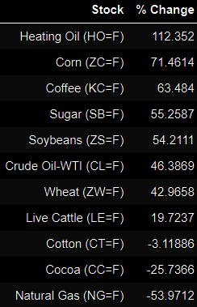
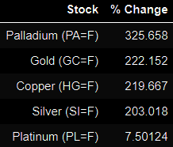
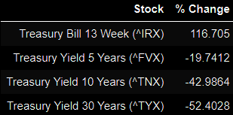
Cleaned Data

Slide 7
Data Visualization

Slide 8
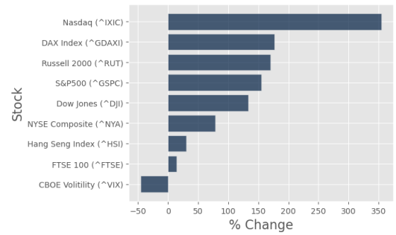
Stock Market Indices January 2003 - January 2023

Slide 9
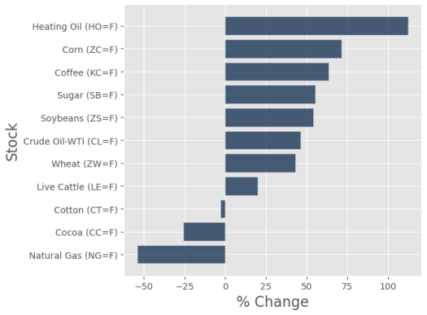
Resources January 2003 - January 2023

Slide 10
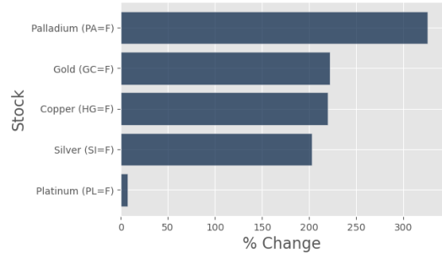
Metals January 2003 - January 2023

Slide 11
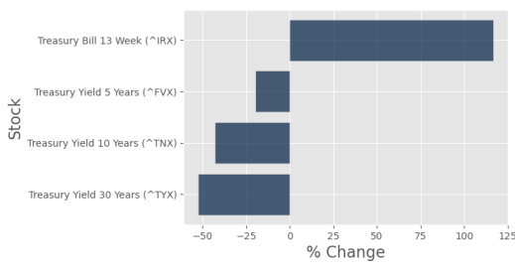
Treasury January 2003 - January 2023

Slide 12
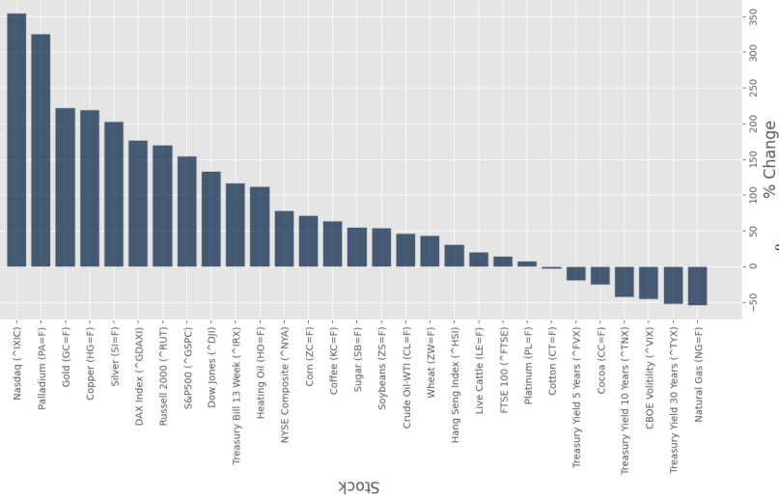
Total Distribution January 2003 - January 2023

Slide 13
Further Insight: The Penny
Pre-1982: 95% Copper and 5% Zinc
1982-Present: 2.5% Copper and 97.5% Zinc
However, the price of zinc has also been increasing over the years relative to the US Dollar.
How has the price of the resources in a penny changed in relation to the penny's printed value of one cent?
(Disclaimer: Do not melt down pennies for their raw materials, it is illegal.)

Slide 14
Conclusion
The stock market index that generated the most revenue from 2003-2023 was the Nasdaq which accrued an approximate 354% change in those 2 decades.
Most Stock Indices on average do not perform as well as most metals long-term, however, they perform better than most resources and treasuries.
This was made using observations of two decades, more investigation is needed to confirm these claims.

Slide 15
The End

